Slide 1
COMPUTER ORGANIZATION AND ARCHITECTURE
Dr. Rizwan Khan
Head – Department of Computer Science and Engineering
(An NBA Accredited Program)
ABES Institute of Technology, Ghaziabad

Slide 2
STATIC RAM
In static RAM, a form of flip-flop holds each bit of memory. A flip-flop for a memory cell takes 4 or 6 transistors along with some wiring, but never has to be refreshed. This makes static RAM significantly faster than dynamic RAM. However, because it has more parts, a static memory cell takes a lot more space on a chip than a dynamic memory cell. Therefore you get less memory per chip, and that makes static RAM a lot more expensive.
Provides a fast access time at the expense of lower bit densities
For this reason registers and cache subsystems are fabricated using SRAM technology
Static RAM is considerably more expensive than Dynamic RAM
However, since it doesn’t need to be refreshed, its power consumption is much lower than DRAM
Also, the absence of the refresh circuitry makes it easier to interface to
The simplicity of the memory circuitry compensates for the more costly technology

Slide 3
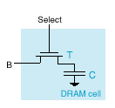
DYNAMIC RAM
Dynamic RAM is the most common type of memory in use today. Inside a dynamic RAM chip, each memory cell holds one bit of information and is made up of two parts: a transistor and a capacitor. The capacitor holds the bit of information -- a 0 or a 1. The transistor acts as a switch that lets the control circuitry on the memory chip read the capacitor or change its state.
A capacitor is like a small bucket that is able to store electrons. To store a 1 in the memory cell, the bucket is filled with electrons. To store a 0, it is emptied. The problem with the capacitor's bucket is that it has a leak. In a matter of a few milliseconds a full bucket becomes empty. Therefore, for dynamic memory to work, either the CPU or the memory controller has to come along and recharge all of the capacitors holding a 1 before they discharge. To do this, the memory controller reads the memory and then writes it right back. This refresh operation happens automatically thousands of times per second.
This refresh operation is where dynamic RAM gets its name. Dynamic RAM has to be dynamically refreshed all of the time or it forgets what it is holding. The downside of all of this refreshing is that it takes time and slows down the memory.

Slide 4
DRAM
The bulk of a processor’s main memory is comprised of dynamic RAM
In contrast to SRAM, DRAM uses a single transistor and capacitor to store a bit
DRAM requires that the address applied to the device be asserted in a row address (RAS) and a column address (CAS)
The requirement of RAS and CAS of course kills the access time, but it allows for higher memory densities
RAS and CAS use the same pins, with each being asserted during either the RAS or the CAS phase of the address
There are two metrics used to describe DRAM’s performance:
Access time is defined as the time between assertion of RAS to the availability of data
Cycle time is defined as the minimum time before a next access can be granted
Cycle times establish throughput of the system
Of course the charge leaks slowly from the storage capacitor in DRAM and it needs to be refreshed continually
During the refresh phase, all accesses are held-off, which happens once every 1 – 100 ms and slightly impacts the throughput

Slide 5
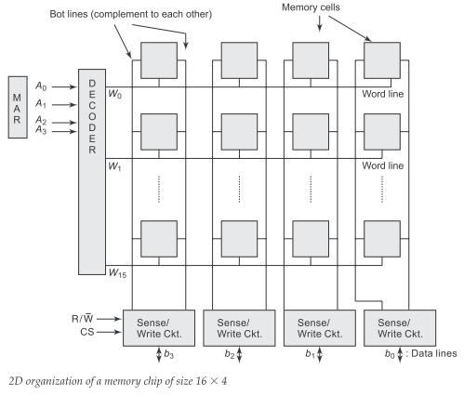
2D MEMORY ORGANIZATION

Slide 6
2D MEMORY ORGANIZATION
The cells are organized in the form of a two-dimensional array with rows and columns.
Each row refers to word line. For 4-bit per word memory, 4 cells are interconnected to a word line. Each column in the array refers to a bit line.
The Memory Address Register (MAR) holds the address of the location where read/write operation is executed.
Here in this example, MAR has 4 bits.
The content of MAR is decoded by an address decoder on the chip to activate each word line.
The cells in each column are connected to a sense/write circuit by two bit lines. Two bit lines are complement to each other.
The sense/write circuits are activated by the chip select (CS) lines. The sense/write circuits are connected to the data lines of the chip.
During a read operation, these circuits sense or read the information stored in the cells selected by a word line and transmit this information to the data lines.
During a write operation, the sense/write circuits receive or write input information from the data lines and store it in the selected cells.

Slide 7


